Slide 1
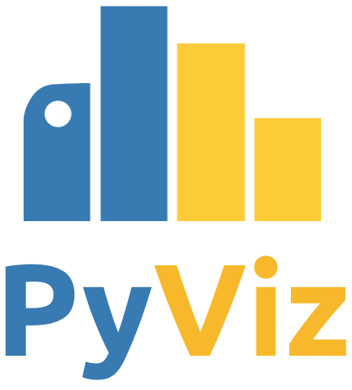
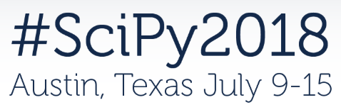
What’s new and
what’s next for PyViz projects
James A. Bednar (Anaconda, Inc.)

Slide 2

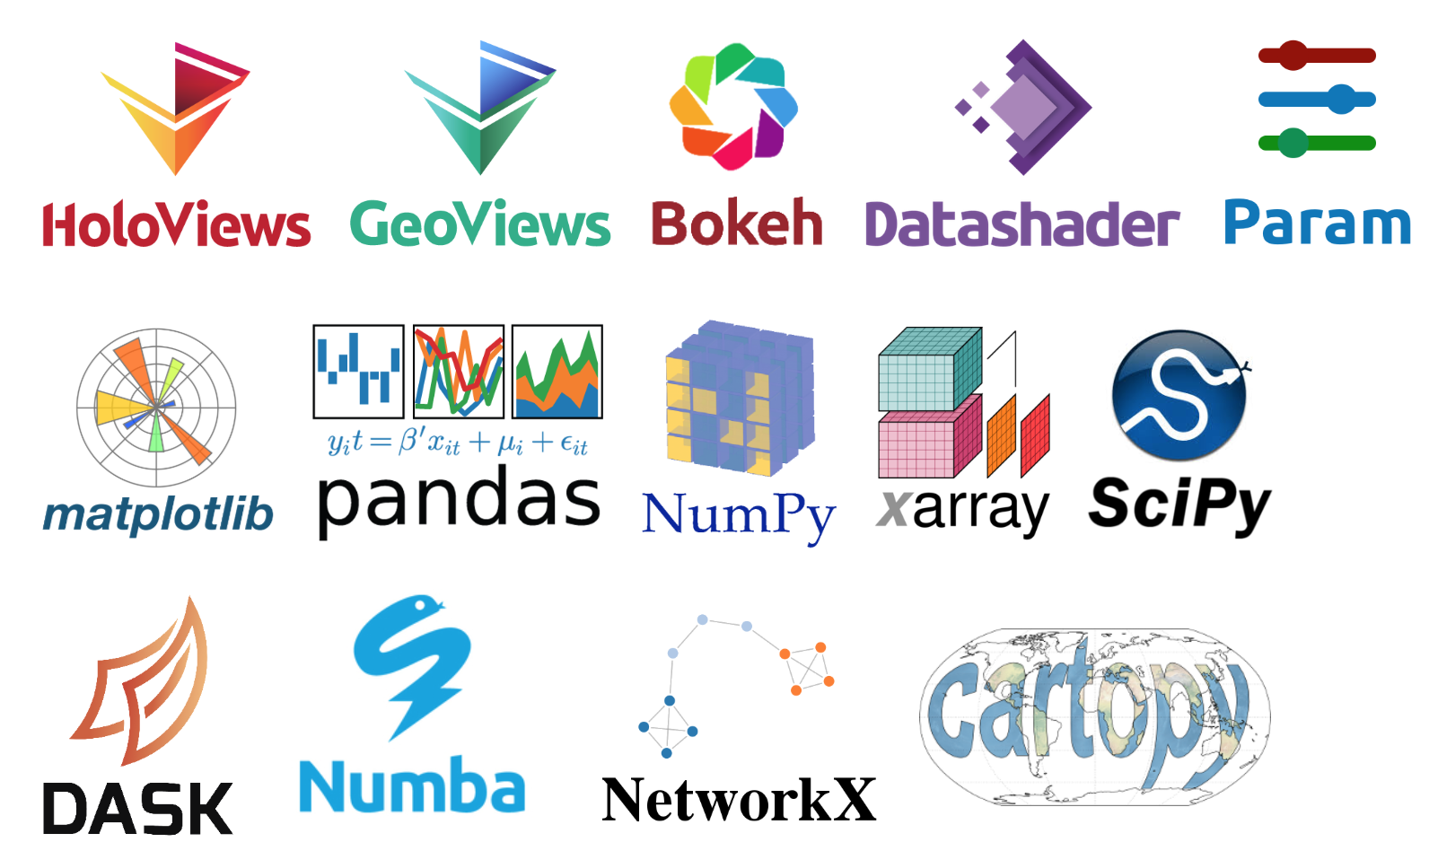
What’s PyViz?
A new joint effort by the authors of HoloViews, GeoViews, Bokeh, Datashader, and Param to make all these packages (and more) work well together:

Slide 3
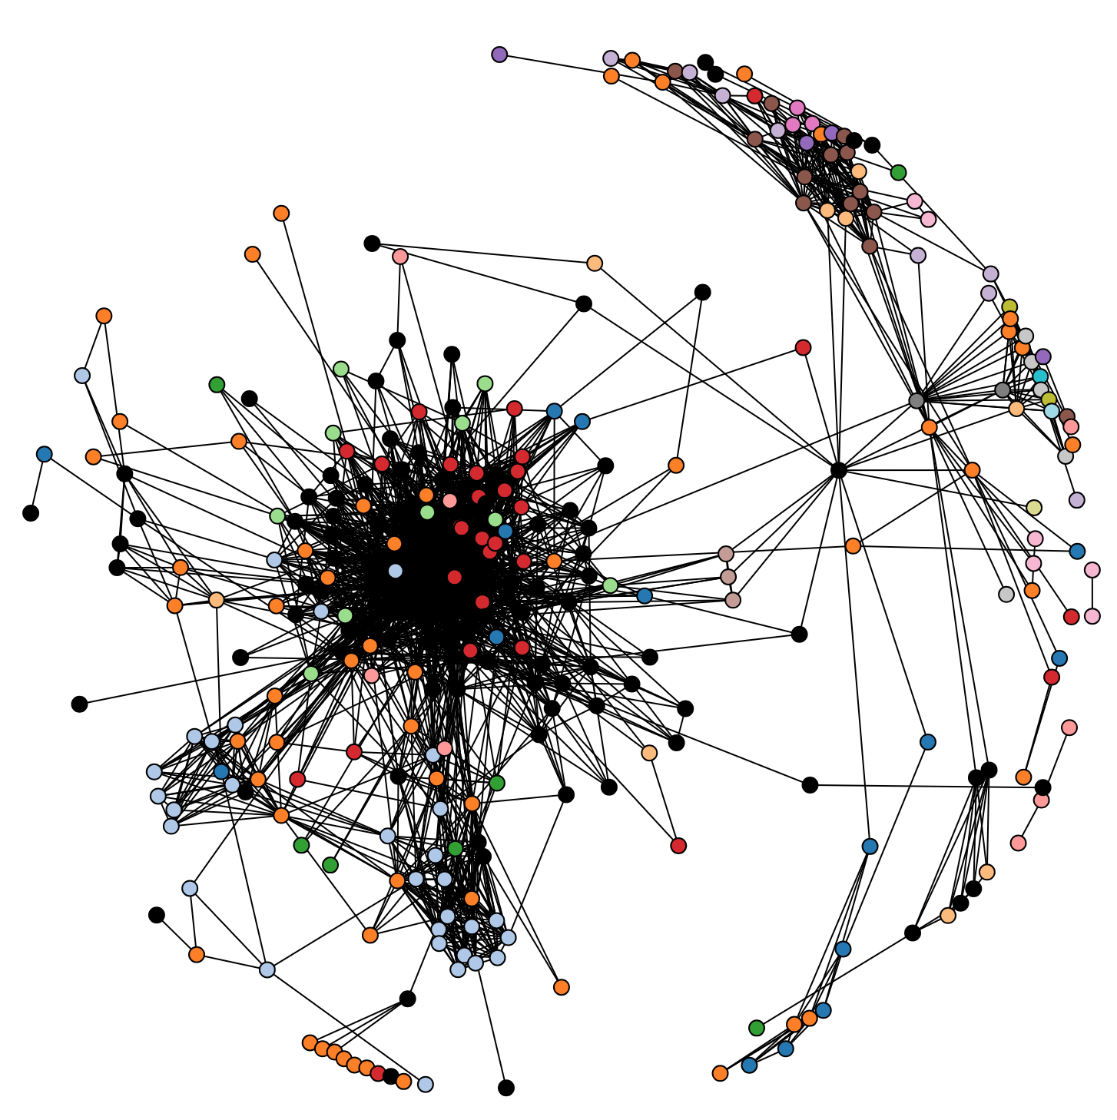
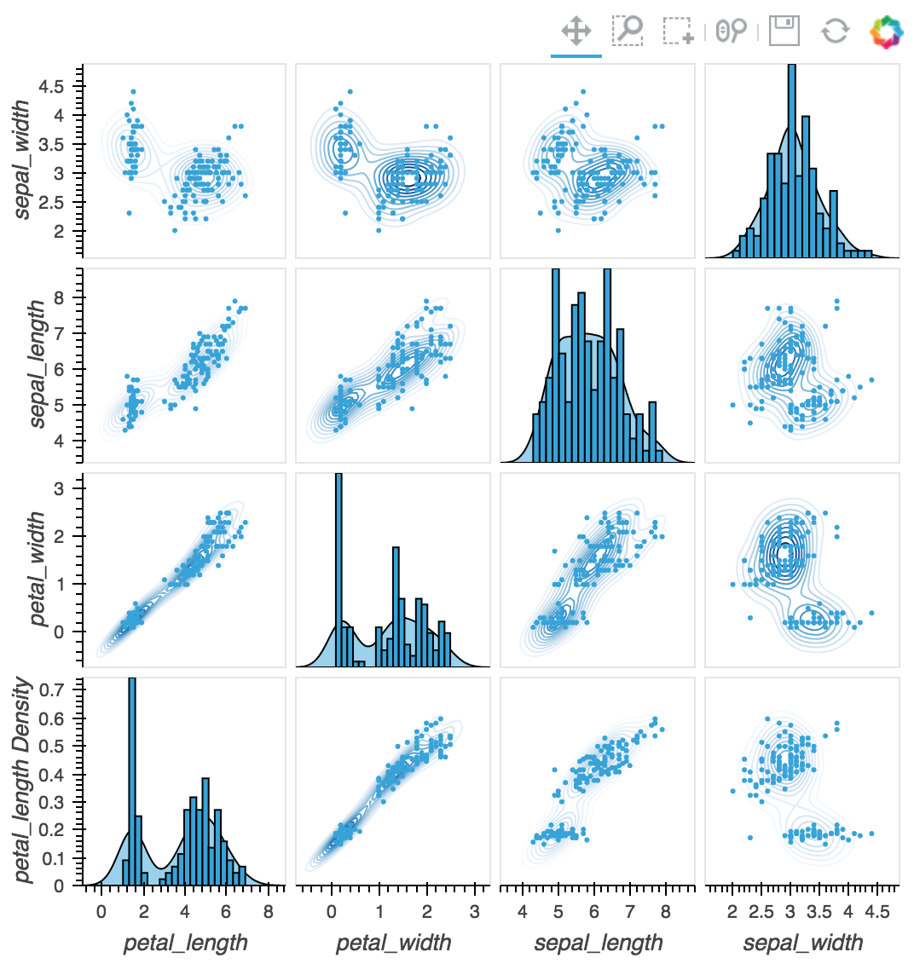
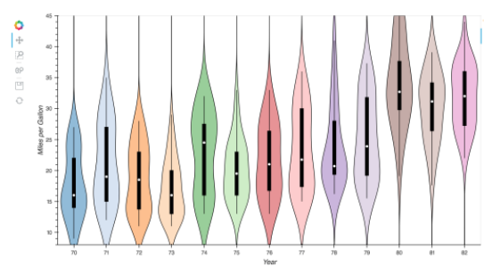
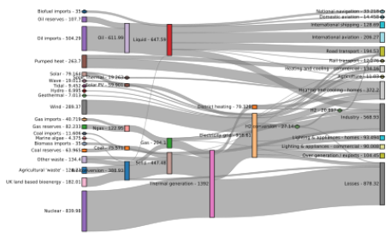
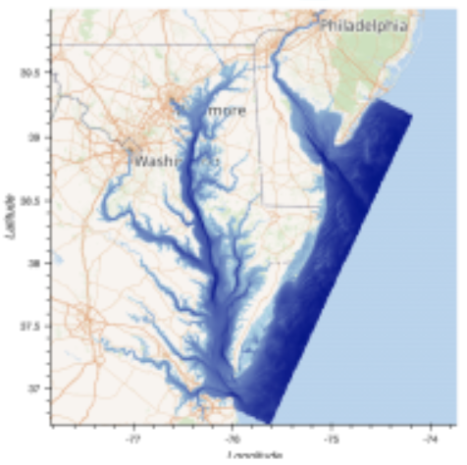
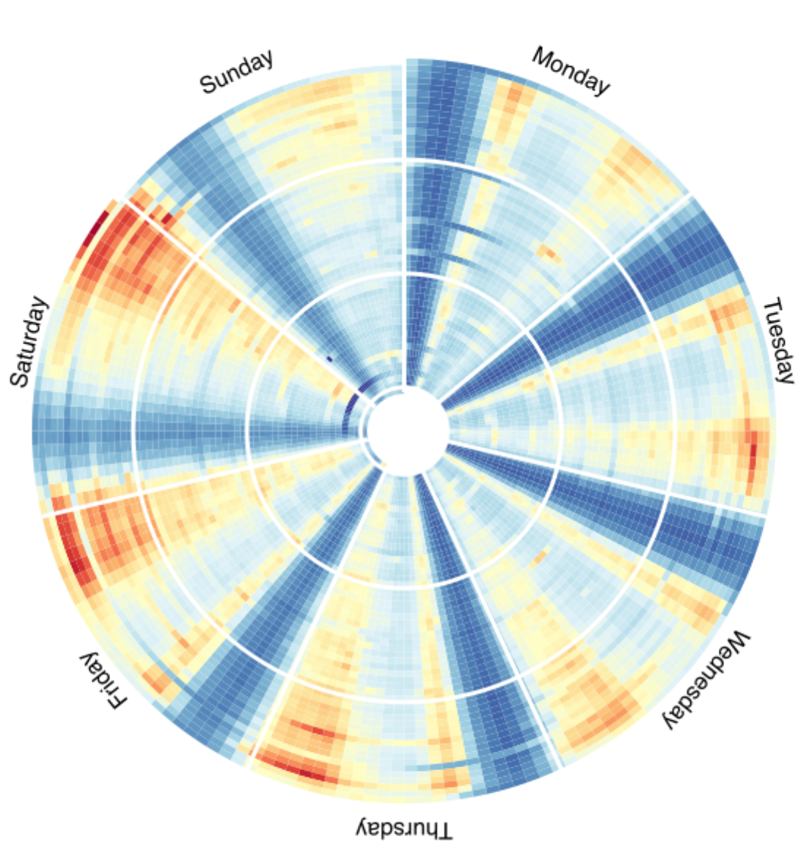
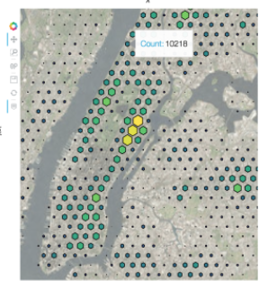
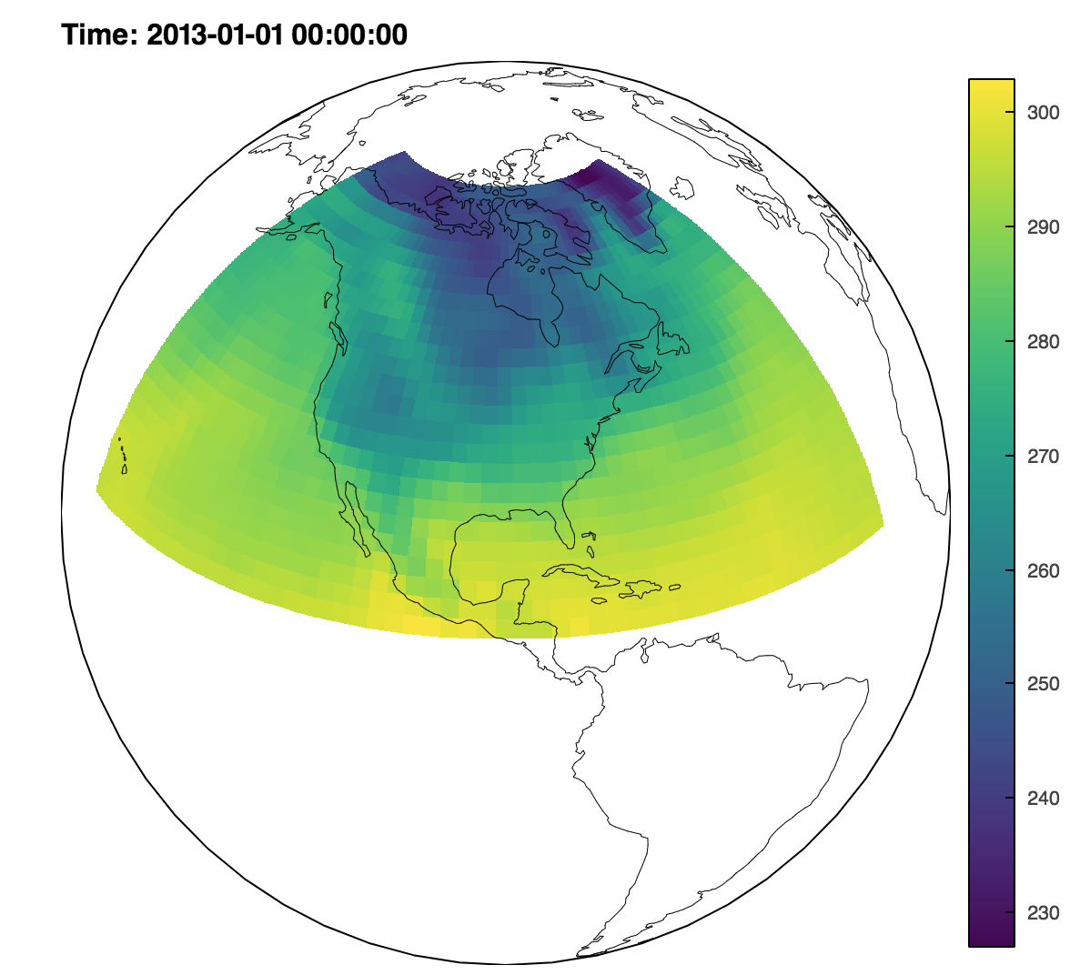
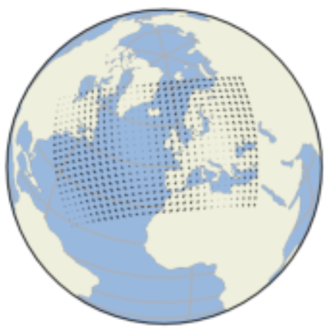
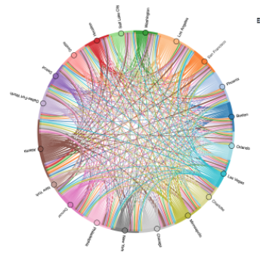
What’s new: More plot types
Graph/network plots (bk, hv, gv, ds)
Interactive Violin, Distribution, Bivariate statistical plots (hv+bk)
Sankey, Chord, HexTiles, Labels, Div, radial Heatmap (hv, gv)
Fast irregular (TriMesh) and regular gridding (hv, gv, ds)
Arbitrary geographic projections (gv+bk, ds)
Streaming support (hv, hvplot)

Slide 4
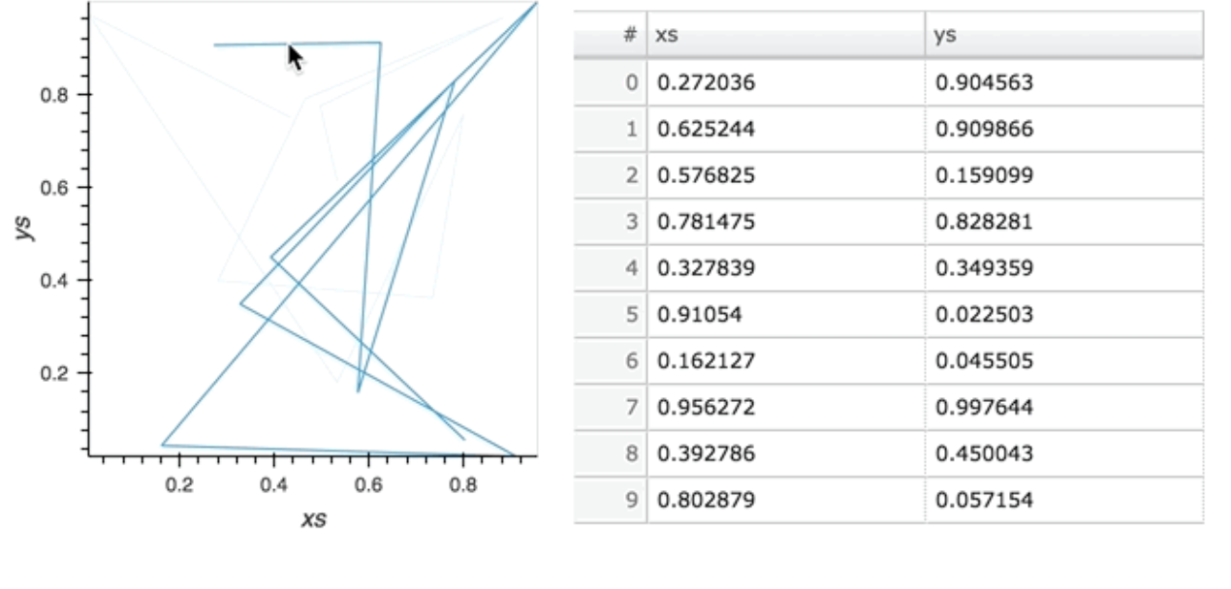
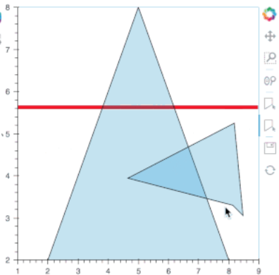
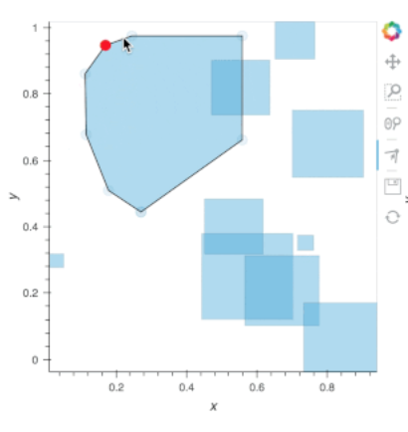
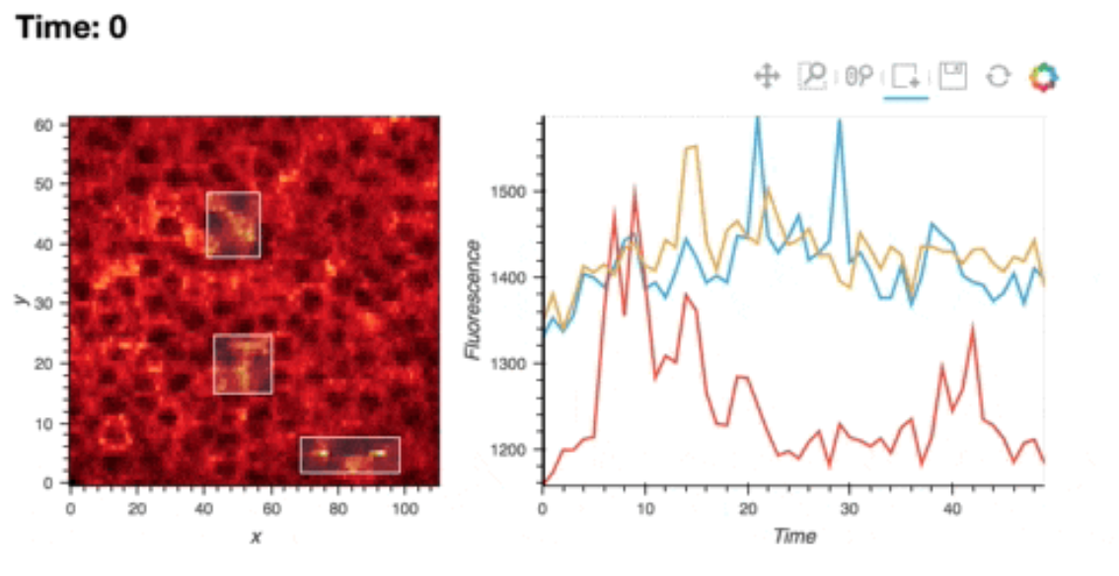
What’s new: Drawing/Editing tools
Bokeh and HoloViews now provide extensive support for:
Adding/editing/drawing data (points, lines, boxes, polygons)
Associating data with attributes (numbers, strings, categories, etc.)
Accessing the new/edited data from within Python
Useful for:
Annotating plots (what’s this outlier? what happened here?)
Collecting user inputs (parameters, algorithm hints, etc.)
Labeling data for machine learning
Making a full GUI in a web browser, if you want!

Slide 5
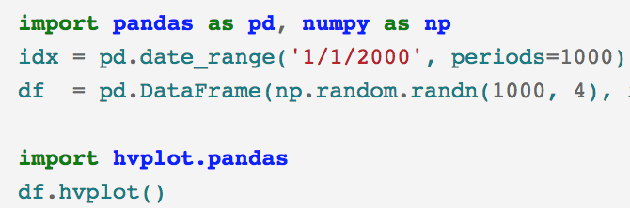
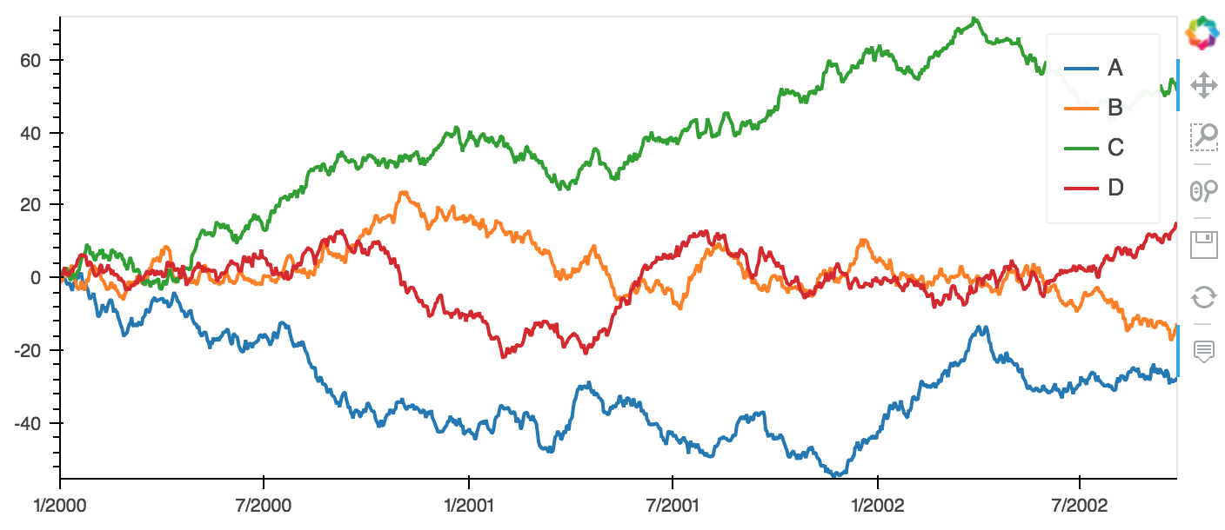
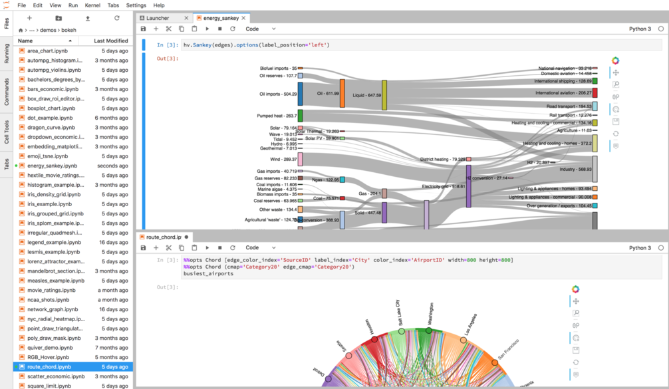
What’s new: Other features
hvPlot: Interactive Bokeh plots from a Pandas-style .plot() interface (hv,gv,ds,bk)
JupyterLab support (bk, hv, gv, param)
Massive speed improvements (bk, hv, gv, ds)
Better datetime and categorical support (bk, hv, gv, ds)
Extensive colormap support (hv, ds, colorcet)

Slide 6
What’s next:
Easier and more flexible support for dashboards
Embedding multiple Bokeh objects in HTML/JS templates
Easier linking of widgets and plots
More powerful linking in static plots (reducing need for deploying Python)
Improved ML and geospatial workflows
Better datashader integration

